Slide 1
AJAX

Slide 2
What is AJAX ?
AJAX stands for asynchronous Javascript and XML
AJAX is not a Programming Language.Rather; it’s a set of existing technologies.
AJAX helps in fetching data asynchronously without interfering with existing page.
No page reload/refresh
Modern website use JSON instead or XML for data transfer

Slide 3
Why Use AJAX?
No page reload/refresh
Better user experience
Saves network bandwidth
Very interactive

Slide 4
How it Works?
User sends a request from the HTML and a javascript call goes to
XMLHttpRequest object.
HTTP Request is sent to the server by open() method of XMLHttpRequest object.
Server interacts with the database (if present) using JSP, PHP, Servlet, ASP.net etc.
Data is retrieved.
Server sends XML data or JSON data or text data to the XMLHttpRequest callback function.
HTML and CSS data is displayed on the browser.

Slide 5
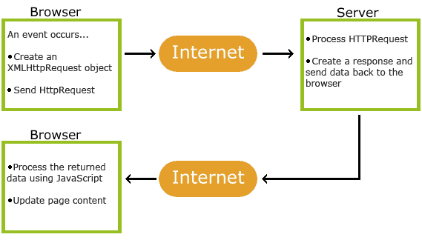
How it Works

Slide 6
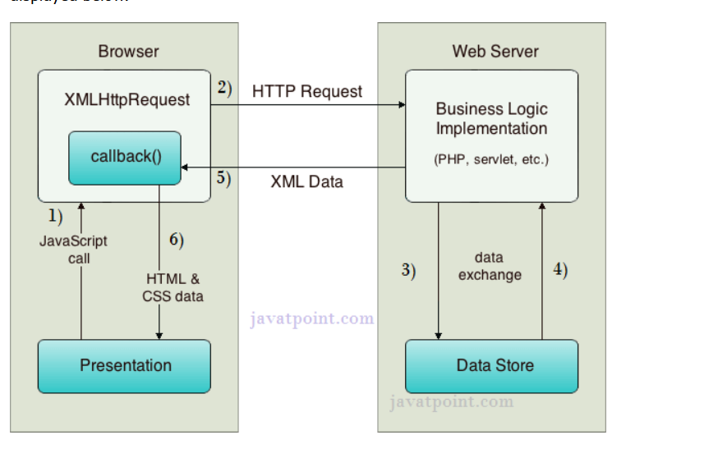
How AJAX works? (better undersTanding)

Slide 7
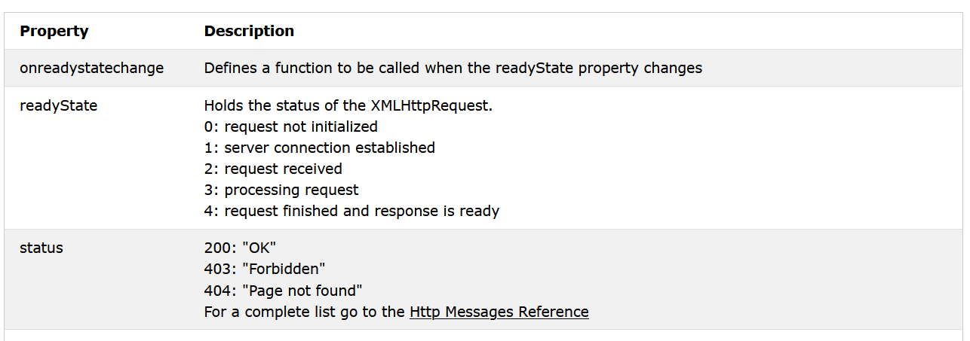
AJAX request methods

Slide 8
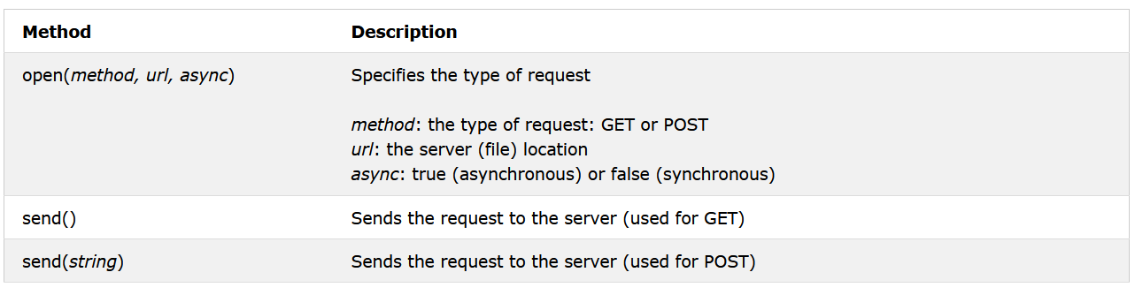
Ajax response methods

